Slide 1
BANK MARKETING
CS 513- A
Abhinav Singh(10410326)
Chinna R Samineni(10408968)

Slide 2


TEAM MEMEBERS
Chinna R Samineni Abhinav Singh
Cwid-10408968 Cwid-10410326

Slide 3
Abstract
Due to the global financial crisis, credit on international markets became more restricted for banks, turning attention to internal clients and their deposits to gather funds. This drive led to a demand for knowledge about client’s behavior towards deposits and especially their response to telemarketing campaigns. This work describes a data mining approach to extract valuable knowledge from recent Portuguese bank telemarketing campaign data. Such approach was guided by the CRISP--DM methodology and the data analysis was conducted using R-tool.

Slide 4

CRISP – DM
We will use the CRISP (Cross-Industry Standard Process for Data Mining) methodology to give the directions of this project. This process, consists in a iterative and adaptive life cycle consisting of 6 phases, as shown on the below picture.

Slide 5
1-Business Understanding-
- This phase focuses on understanding the project objectives
and requirements.
- Converting knowledge into data mining problem and definition.
2-Data Understanding-
- Getting familiar with the data
-Identifying data quality problems
3-Data Preparation-
-covers all activities to construct the final dataset
4-Modelling-
- Various Modelling techniques are selected and applied.
5-Evaluation-
-Reviewing the steps used to execute the model
6-Deployment-
-interacting with customer and making customer
understand the model.

Slide 6
Business Understanding
Business Problem
A Portuguese retail bank uses its own contact-center to do direct marketing campaigns, mainly through phone calls (telemarketing). Each campaign is managed in an integrated fashion and the results for all calls and clients within the campaign are gathered together, in a flat file report concerning only the data used to do the phone call. Often, more than one contact to same client was required, in order to access if the product (bank term deposit) would be (or not) subscribed. The computer application to execute the telemarketing campaigns is in use since the end of 2007, and it performs several tasks, such as launching automatic client calls and producing the reports with the final campaign results. The classification goal is to predict if the client will subscribe (yes/no) a term deposit (variable y).

Slide 7
Data Understanding
We have used the Bank Marketing dataset of a Portuguese banking institution from the UCI repository.
No. of instances: 45211
No. of attributes: 16 + Output variable
http://archive.ics.uci.edu/ml/datasets/Bank+Marketing

Slide 8
Attribute information:
Input variables:
# bank client data:
1 - age (numeric)
2 - job : type of job
Categorical:
admin
unemployed
management
housemaid
entrepreneur
student

Slide 9
blue-collar
self-employed
retired
technician
services
3 - marital : marital status
Categorical:
married
divorced
single
(divorced means divorced or widowed)
4 - education
Categorical:
secondary
primary
tertiary

Slide 10
5 - default: has credit in default?
binary: yes,no
6 - balance: average yearly balance, in euros (numeric)
7 - housing: has housing loan?
binary: yes,no
8 - loan: has personal loan?
binary: yes,no
# related with the last contact of the current campaign:

Slide 11
9 - contact: contact communication type
categorical:
telephone
cellular
10 - day: last contact day of the month (numeric)
11 - month: last contact month of year (categorical: "jan", "feb", "mar", ..., "nov", "dec")
12 - duration: last contact duration, in seconds (numeric)

Slide 12
# other attributes:
13 - campaign: number of contacts performed during this campaign and for this client (numeric, includes last contact)
14 - pdays: number of days that passed by after the client was last contacted from a previous campaign (numeric, -1 means client was not previously contacted)
15 - previous: number of contacts performed before this campaign and for this client (numeric)

Slide 13
16 - poutcome: outcome of the previous marketing campaign categorical:
other
failure
success
Output variable (desired target):
17 - y - has the client subscribed a term deposit? (binary: "yes","no")
Missing Attribute Values: None

Slide 14
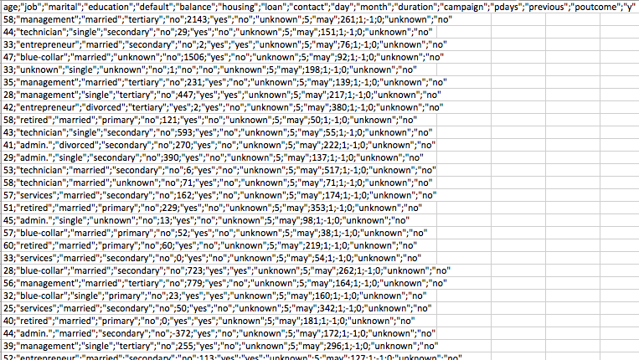
Data Preparation
Original dataset

Slide 15
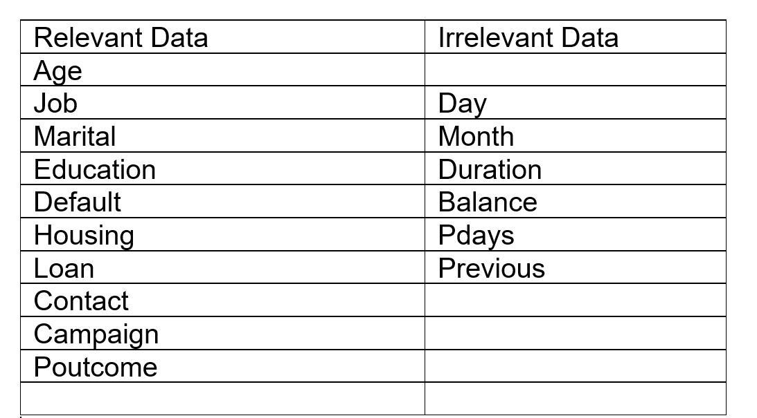
Data Preparation
-Initially all the unknown values were deleted.
-Variables were categorized into Relevant and irrelevant variables.

Slide 16
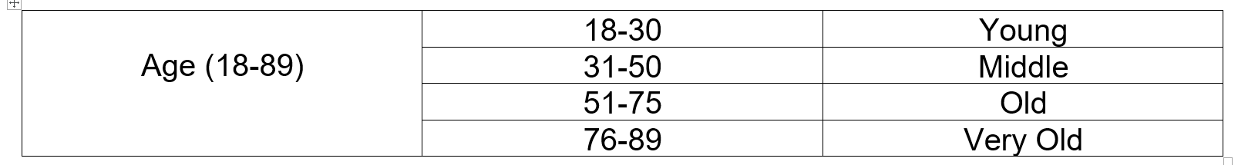
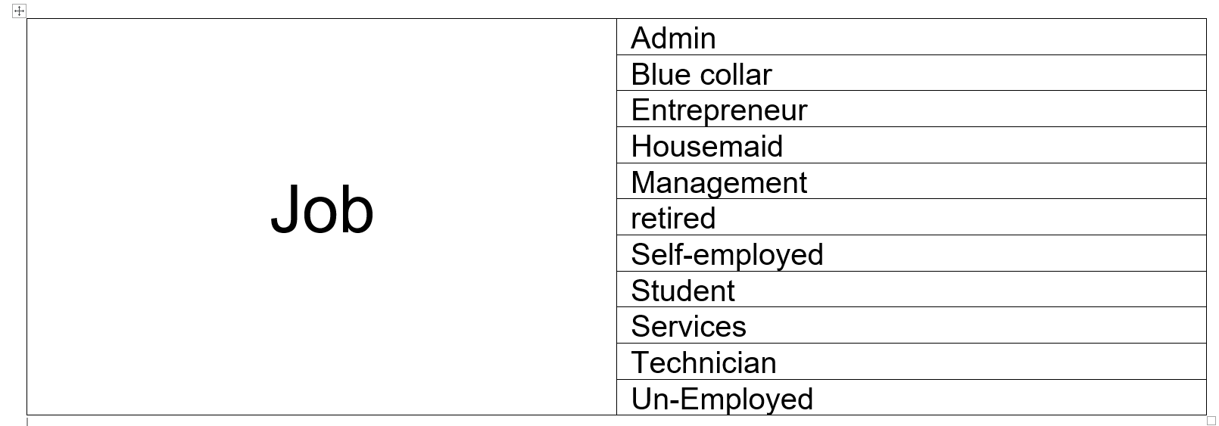
Categorization and Factorization were implemented

Slide 17
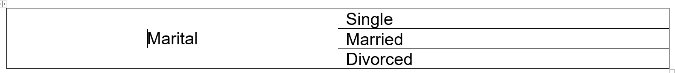
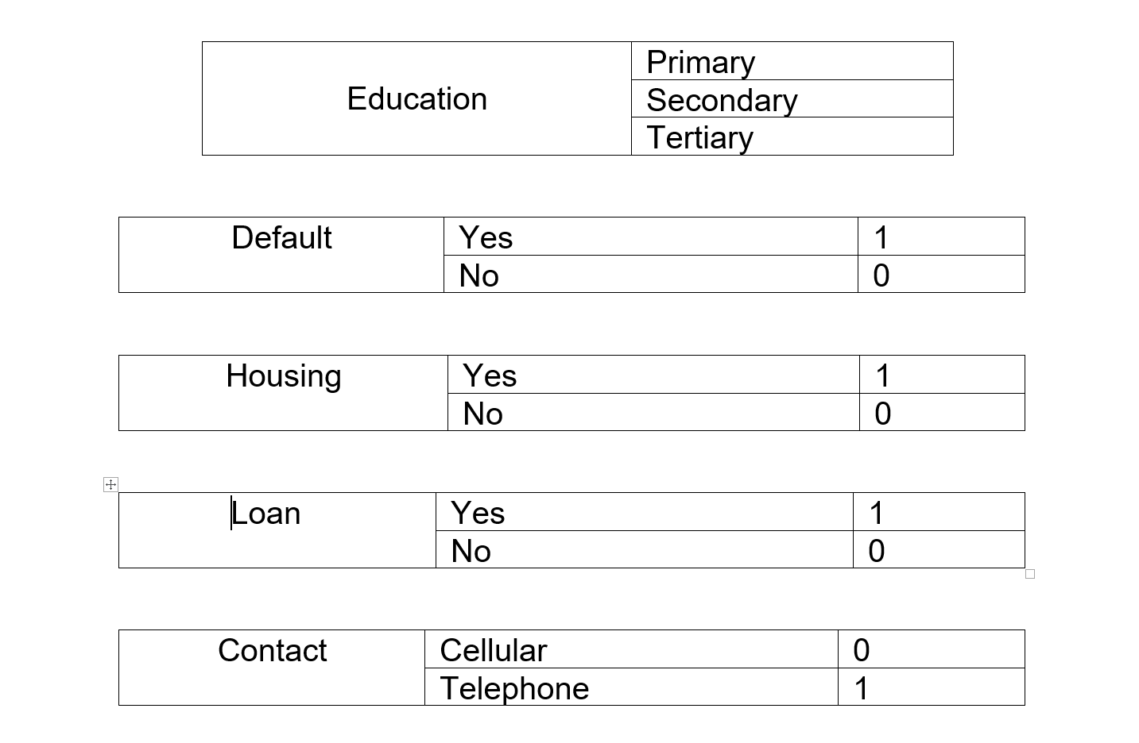

Slide 18
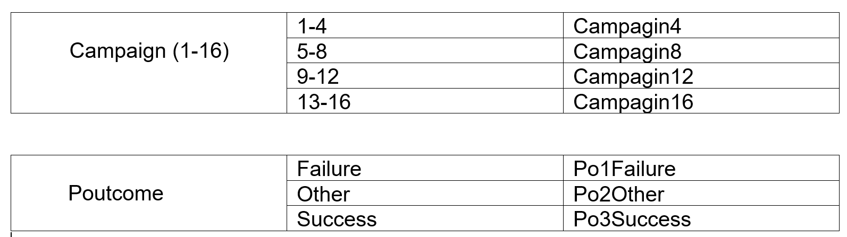

Slide 19
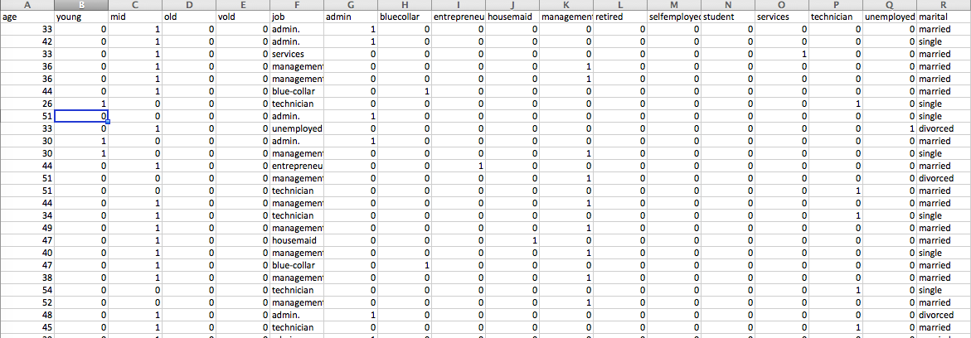
Data Preparation
Cleaned dataset
No. of instances: 7843

Slide 20
Modelling
We first split the dataset into training and testing with 80:20 ratio.
Training Data
Testing Data
Contains 6273 observations with 33 variables
Contains 1569 observations with 32 variables

Slide 21
Modelling
Algorithms Used
K-Nearest Neighbors (K-NN)
Weighted K-Nearest Neighbors (KK-NN)
Decision Tree: CART

Slide 22
Modelling
KNN
kNN stands for k - Nearest Neighbor
kNN does not make any assumptions on the underlying data distribution.
The k-Nearest Neighbor algorithm is an example of instance-based learning where training set records are first stored
Next, the classification of a new unclassified record is performed by comparing it to records in the training set it is most similar to
k-Nearest Neighbor is used most often for classification, although it is also applicable to estimation and prediction tasks

Slide 23
Modelling
KNN Explained
A case is classified by a majority vote of its neighbors, with the case being assigned to the class most common amongst its K nearest neighbors measured by a distance function.
If K = 1, then the case is simply assigned to the class of its nearest neighbor.
Choosing the optimal value for K is best done by first inspecting the data.

Slide 24
Modelling
KNN Graph
K Value | Result
K=1 | 79.41364
K=3 | 80.94328
K=5 | 81.19822
K=7 | 81.26195
K=9 | 81.00701
K=11 | 80.87954

Slide 28
Modelling
KKNN (Weighted KNN)
Since KNN predictions are based on the assumption that objects close in distance are potentially similar.
It makes good sense to discriminate between the K nearest neighbors when making predictions, i.e., let the closest points among the K nearest neighbors have more say in affecting the outcome of the query point.

Slide 29
Modelling
KKNN Graph
K Value | Result
K=1 | 76.67304
K=3 | 62.07776
K=5 | 51.81644

Slide 33
Modelling
Classification and Regression Tree
The purpose of the analysis via tree-building algorithm is to determine a set of if-then logical split conditions that permit accurate predictions or classification of cases.
A Classification tree will determine a set of logical if-then conditions instead of linear equations for predicting or classifying cases.
The general approach to derive predictions from if-then conditions can also be applied to regression tree as well.
Advantages of CART:
Simplicity
Nonparametric and Nonlinear

Slide 34
Modelling
CART Summary
rpart(formula = y ~ ., data = newtraining, control = rpart.control(maxdepth = 10))
n= 6273
CP nsplit rel error xerror xstd
1 0.22552699 0 1.0000000 1.0003732 0.01650402
2 0.02538551 1 0.7744730 0.7749534 0.01709562
3 0.01000000 2 0.7490875 0.7498183 0.01611865
Variable importance
po3success housing retired
89 10 1

Slide 35
Modelling
CART Summary
Node number 1: 6273 observations, complexity param=0.225527
mean=0.2265264, MSE=0.1752122
left son=2 (5123 obs) right son=3 (1150 obs)
Node number 2: 5123 observations, complexity param=0.02538551
mean=0.1323443, MSE=0.1148293
left son=4 (3584 obs) right son=5 (1539 obs)
Node number 3: 1150 observations
mean=0.646087, MSE=0.2286586
Node number 4: 3584 observations
mean=0.08398438, MSE=0.076931
Node number 5: 1539 observations
mean=0.2449643, MSE=0.1849568

Slide 36
Evaluation - KNN
K=7 | 0 | 1
0 | 1125 | 79
1 | 215 | 150
81.26% of good predictions!

Slide 37
Evaluation - KNN
K Value | Result
K=1 | 79.41364
K=3 | 80.94328
K=5 | 81.19822
K=7 | 81.26195
K=9 | 81.00701
K=11 | 80.87954
81.26% of good predictions!

Slide 38
Evaluation - KKNN
K Value | Result
K=1 | 76.67304
K=3 | 62.07776
K=5 | 51.81644
76.67% of good predictions!

Slide 39
Evaluation - CART
n= 6273
node), split, n, deviance, yval
* denotes terminal node
1) root 6273 1099.1060 0.22652640
2) po3success< 0.5 5123 588.2705 0.13234430
4) housing>=0.5 3584 275.7207 0.08398438 *
5) housing< 0.5 1539 284.6485 0.24496430 *
3) po3success>=0.5 1150 262.9574 0.64608700 *
77.49% of good predictions!

Slide 40
Evaluation – Accuracy Comparison

Slide 41
Deployment
EQUATIONS
KNN
newpredict<-knn(newtraining[,-33], newtest[,-33],newtraining[,33],k=1)
newresults<-cbind(newtest,as.character(newpredict)) # adds new column from the result
table(newresults[,33],newresults[,34])
df<-as.data.frame(table(newresults[,33],newresults[,34]))
good_predictions<-sum(df$Freq[df$Var1==df$Var2])
total_predictions<- sum(df$Freq)
successrate_K_1 <- (good_predictions/total_predictions) * 100
successrate_K_1

Slide 42
Deployment
EQUATIONS
KKNN
newpredict <- kknn(y~., newtraining, newtest, distance=1,k=1)
#summary(newpredict)
fit <- fitted(newpredict)
s<-table(newtest$y, fit) # table gives the result in tabular form
View(s)
correct<-fit== newtest$y
rate<-sum(correct)/length(correct)
rate

Slide 43
Deployment
EQUATIONS
CART Decision Tree
fit <- rpart(y~., data=newtraining, control=rpart.control(maxdepth = 10))
printcp(fit)
# Plot the fit
plot(fit)
text(fit,pretty=1 )
#Predict on the test dataset
results <- predict(fit, newdata=newtest, type="class")

Slide 44
Thank You

